Slide 1
Exploratory Data Analysis
of 2017 Suicide Rates
Data Obtained from CDC - Wonder Platform
Including 1999 - 2017 Suicide Mortality Rates
Accessed at http://wonder.cdc.gov/ucd-icd10.html
Notes:
#import tab delimited data from CDC - Wonder -Program
#Centers for Disease Control and Prevention, National Center for Health Statistics.
#Underlying Cause of Death 1999-2017 on CDC WONDER Online Database, released December, 2018.
#Data are from the Multiple Cause of Death Files, 1999-2017, as compiled from data provided
#by the 57 vital statistics jurisdictions through the Vital Statistics Cooperative Program.
#Accessed at http://wonder.cdc.gov/ucd-icd10.html

Slide 2
US 2017 Data Interpretation
Total deaths : 43, 768
Males make up approximately 80% : 34, 836 deaths
White males are 92.6%
Black of African American males are 4.98%
Asian or Pacific Islander males are 1.74%
Alaskan or Native Americans males are 0.63%
Gender Distinction: Males and Females used vs Men & Women

Slide 3
US 2017 Data Interpretation Cont.
Total deaths : 43, 768
Females make up approximately 20% : 8,932 deaths
White females are 95.10%
Black of African American females are 2.54%
Asian or Pacific Islander females are 2.01%
Alaskan or Native Americans females are 0.63%
Gender Distinction: Males and Females used vs Men & Women

Slide 4
Categorical Methods Employed In Suicide
By Males and Females Sorted Popular Rank
53.24% Firearms : 23,303
28.48% Suffocation: 12,466
14.01% Poisoning: 6,136
1.65% Fall : 722
1.23% Cutting or Piercing : 537
0.95% Other Classifiable : 418
0.40% Drowning : 176
0.02% Flame / Fire : 10

Slide 5
Hypothesis Testing Results:
Question: What is the likelihood Males would choose this over Females?
Null: There is an equal likelihood that Males and Females would choose Method One over Method Two ( Distinction: In a dataset of Successful Attempts / Completed Suicides )
By Firearm vs Suffocation
With 99-100 % confidence that Males choose Firearm over Suffocation.
There is at least a 41.68% higher difference between Males choosing Firearms over Suffocation than Females.

Slide 6
Hypothesis Testing Results:
Question: What is the likelihood Males would choose this over Females?
Null: There is an equal likelihood that Males and Females would choose Method One over Method Two ( Distinction: In a dataset of Successful Attempts / Completed Suicides )
By Fall vs Cutting/Piercing
With 95 % confidence that Males choose Cutting / Piercing rather than Falling.
There is at least a 22% lower difference between Males choosing Cutting/Piercing than Females.

Slide 7
Hypothesis Testing Results:
Question: What is the likelihood Males would choose this over Females?
Null: There is an equal likelihood that Males and Females would choose Method One over Method Two ( Distinction: In a dataset of Successful Attempts / Completed Suicides )
By Suffocation vs Poisoning
With 99-100 % confidence that Males choose Suffocation rather than Poisoning.
There is at least a 0-1% higher difference between Males choosing Suffocation than Females.

Slide 8


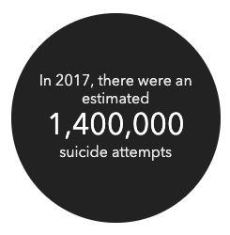


Trends Reported on External Resource Website (Outside Our Dataset )

Slide 9
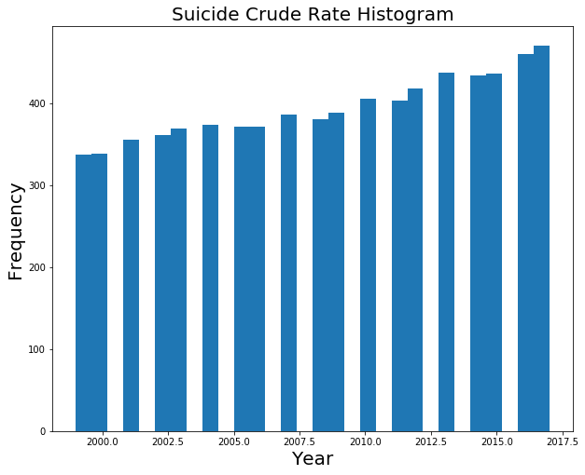
Data Visualization: Data Selection
Initial 1999 - 2017 dataset was selected from CDC Wonder Platform

Slide 10
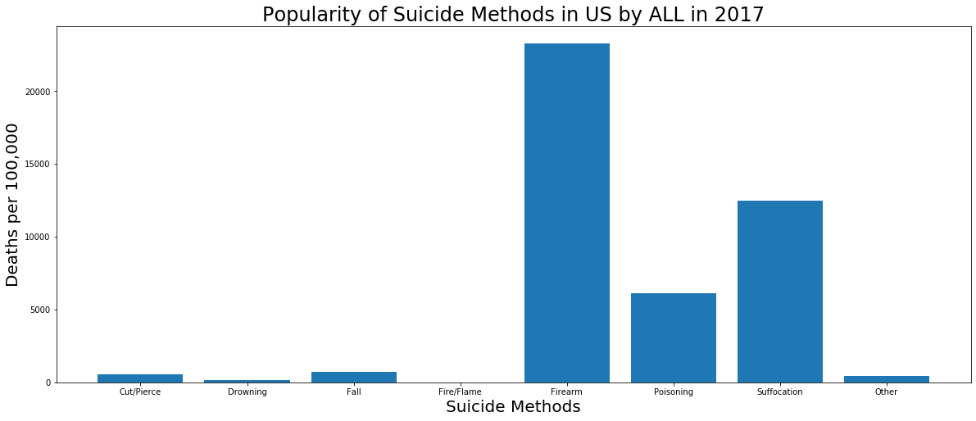
Dataset Narrowed To 2017
With Focus on Method Popularity

Slide 11
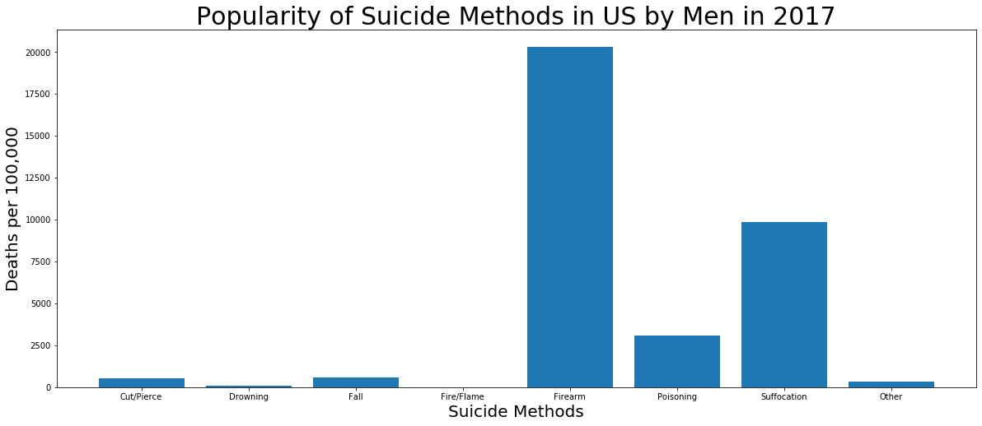
Dataset Narrowed To 2017
With Focus on Method Popularity

Slide 12
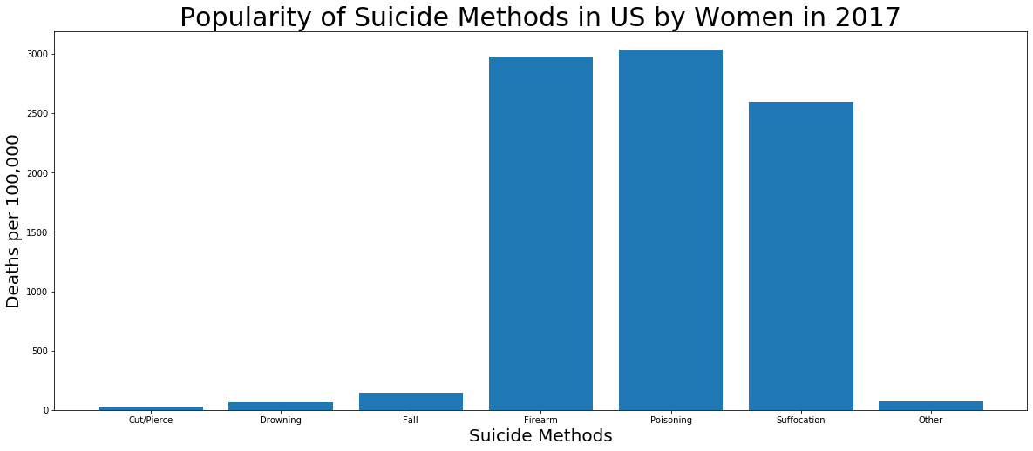
Dataset Narrowed To 2017
With Focus on Method Popularity

Slide 13
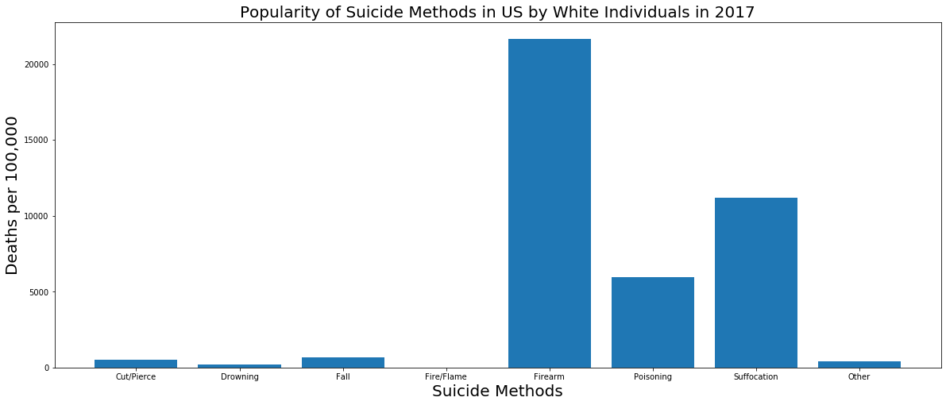
Dataset Narrowed To 2017
With Focus on Method Popularity

Slide 14
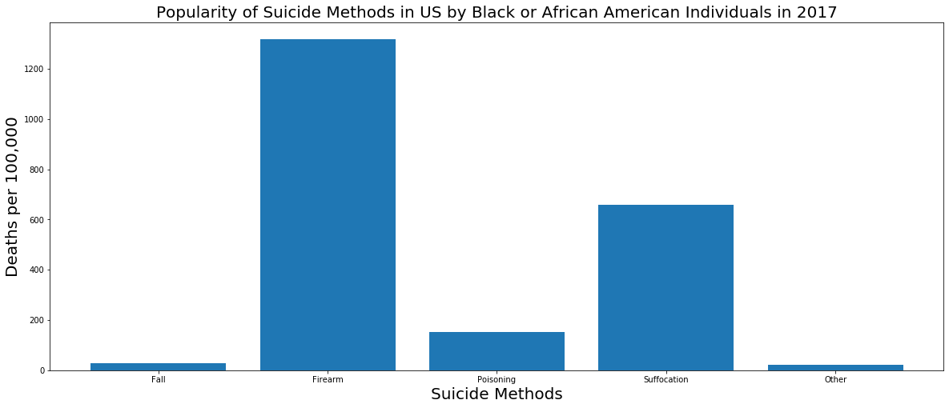
Dataset Narrowed To 2017
With Focus on Method Popularity

Slide 15
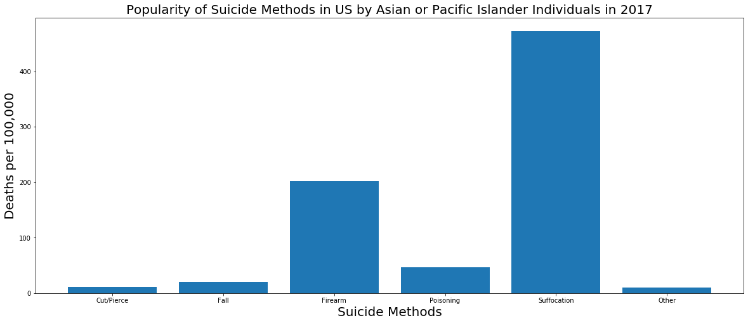
Dataset Narrowed To 2017
With Focus on Method Popularity

Slide 16
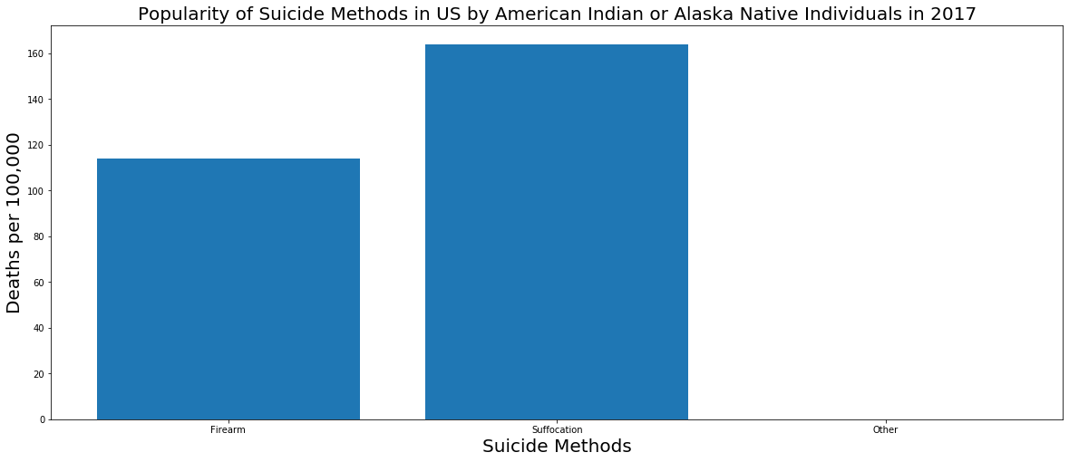
Dataset Narrowed To 2017
With Focus on Method Popularity

Slide 17
Dataset Narrowed To 2017
With Focus on Method Popularity

Slide 18
Dataset Narrowed To 2017
With Focus on Method Popularity

Slide 19
Dataset Narrowed To 2017
With Focus on Method Popularity

Slide 20
Dataset Narrowed To 2017
With Focus on Method Popularity

Slide 21
Dataset Narrowed To 2017
With Focus on Method Popularity

Slide 22
High Level Review Of Data Clean Up
#Drop all redundant Code Columns
#Shorten Injury Mechanism To Method, to describe method of suicide.
#Cleared the word ‘Unreliable’ in crude rate and replaced with 0
#Changed appropriate string and float columns to int32

Slide 23
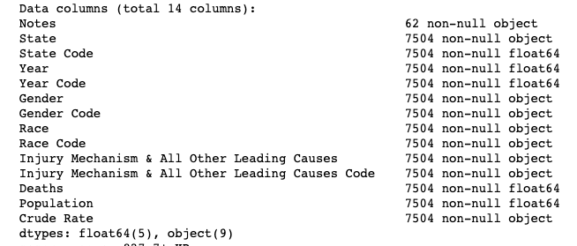
Dropped All Redundant Code Columns

Slide 24
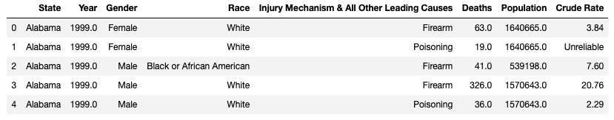
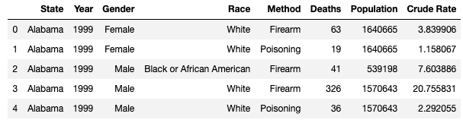
Changed appropriate string and float columns to int32

Slide 25
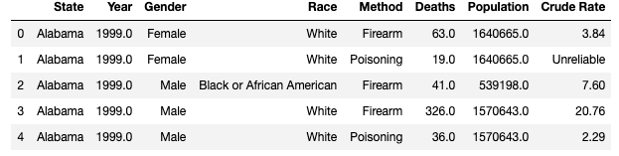
‘Shortened Column ‘Injury Mechanism’ To ‘Method’

Slide 26
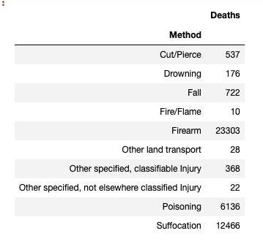
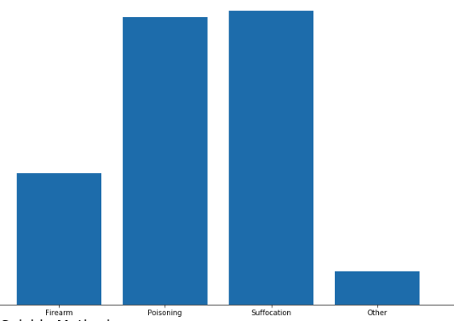
Combined Multiple Other Methods into single ‘Other’ Method

Slide 27



Recalculated Crude Rate: ‘Unreliable’ to float ‘0’ Then Recalculated Rates

